Slide 1

SARIT
By Team JKJ

Slide 2
Agenda
1
2
3
4
5
Problem
Opportunity
Implementation
Reading Redefined
Summary

Slide 3
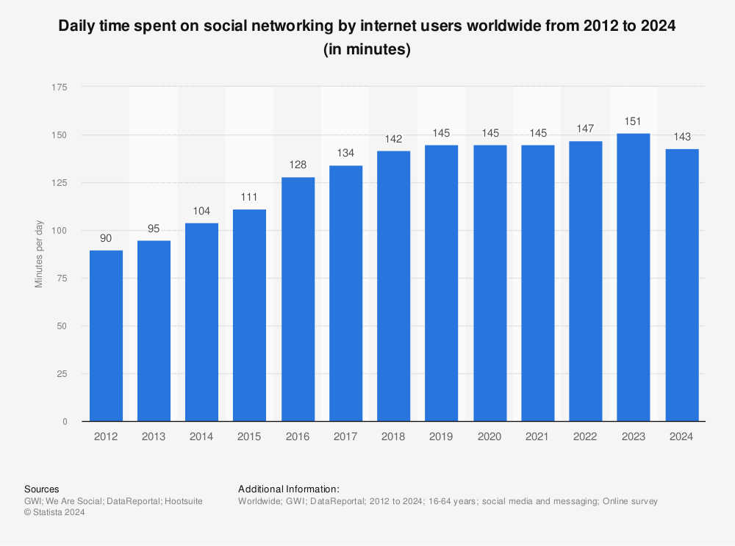
Everyone is Online
As of 2024, the average daily social media usage of internet users worldwide amounted to 143 minutes per day. During a global online user survey in February 2019, a significant share of respondents stated that social media had increased their access to information, ease of communication, and freedom of expression.

Slide 4

Feeds are Important
We preserved our feeds on YouTube to avoid distracting content landing in our feed. Feeds have a positive feedback loop allowing you to explore more educational content by watching educational content.

Slide 5
And Feeds are POWERFUL . . . Take a moment to reflect how much you know because of what landed on your social media feeds

Slide 6
46% of All General Information is Gained Online
According to a survey conducted by our team

Slide 7
89% of Knowledge Was Gained Online by Quiz Toppers
Conducted as a part of the survey

Slide 8

But Most People Misuse Feeds

Slide 9
Because friends can share bogus content So, we got you a new friend™

Slide 10
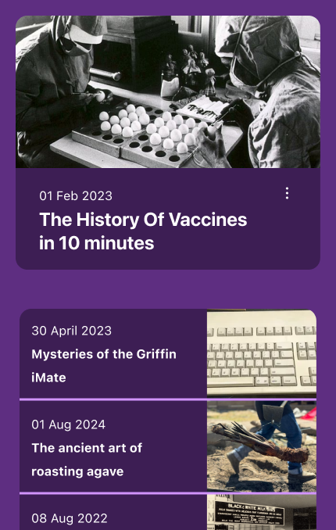
Sarit is your new friend™
Sarit will curate your feed from various sources across the internet and share it with you

Slide 11

What Sarit Curates
Videos
Articles & Posts
And a brand-new media format
We will curate the best educational videos from various sources fine-tuned to your interests. The world’s best educators and institutions are already creating free videos for you to watch, why pay someone to teach you?
If you have a habit of reading, you are in luck. We wish to revive RSS feeds with our product. We will curate the best news and educational articles and blog posts from reputed sources across the internet and provide a platform for engagement.​

Slide 12
How Sarit Curates
Content Corpus
Maintain a giant corpus of educational channels, and different sources and setup automatic triggers on new content releases
Allow users to submit nominations for new sources and/or content creators
ML-Based Recommendation Algorithm
Add transcript to relevant forms of content and create vector embeddings for similarity search
Recommend content based on history of people with similar interests

Slide 13





Why Sarit Curates
Internet newcomers don’t know where to start from
Internet is equitable and easily accessible by a majority of the world’s population
Internet can be the most powerful and effective tool to shape education
Most of the educational content is already there, people just need to discover it
Sarit is a small step towards achieving the SDG of Quality Education

Slide 14

Summary
Sarit is a revolutionary gift to the online world. Sarit is a medium for educators to reach a curious and interested audience, while being a medium for students across the world to discover the best content directly in their feeds. Together, we can achieve Quality Education.

Slide 15
Thank you
By Team JKJ

